Slide 1
Bias, Fairness and Transparency
Miranda Mowbray
miranda.mowbray@bristol.ac.uk

Slide 2
With great power comes great responsibility
Notes:
Just because this was said by a fictional character doesn’t mean it isn’t true

Slide 3
This session includes
- COMPAS algorithm – topic from Jono
- Donated organ allocation – topic from Moses
- Some references for debiasing methods
- Sources of algorithmic bias – topic from David
Virtual office hour: email me
Slides, with references, will be available
Notes:
I have a virtual office hour: email me if you’d like to ask about or discuss anything in my sessions, and I’ll fix up a time to talk with you, probably by Zoom.
Thanks to all of you who suggested topics, I’m going with these three.

Slide 4
Bias, fairness and transparency
Bias, unfairness in this session:
Systematic unwanted outcomes for a particular demographic group
(not statistical bias or inductive bias)
Transparency in this session:
focus is on communication to stakeholder about how decision algorithm works.
Other aspects of transparency - see Ethics guidelines for Trustworthy AI
Notes:
The unit programme asks whether inductive bias is always a bad thing. It isn’t. Inductive bias is the simplifying assumptions made in a model. All models are all simplifications of the real picture, but some are useful because their simplifications lead quickly to reasonably accurate results. So inductive bias can be a good thing.
Anyway, what I’ll be talking about in this session is demographic bias.

Slide 5
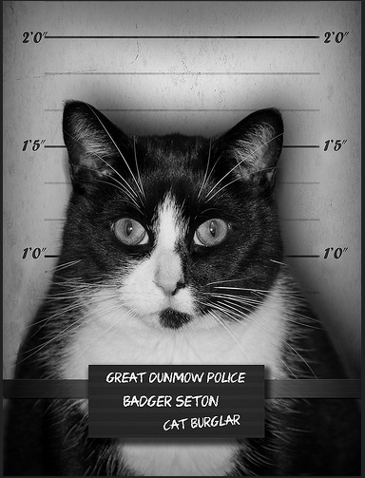

COMPAS ALGORITHM
Mark Seton / markseton on Flickr
https://www.flickr.com/photos/markseton/10766023213/
Notes:
I’ll talk now about the COMPAS algorithm, which a predictive algorithm used in some parts of the US to decide whether or not a convicted criminal (like this cat burgler) is at high risk of being rearrested if they’re freed on parole, so as to help a parole board decide whether they need to continue to be locked up or whether they can be released. It’s thought that COMPAS uses machine learning, but this isn’t clear, as the algorithm is proprietary.

Slide 6
Objections to this sort of algorithm
Distracts from the big issue: US incarceration rate
- One of world’s highest, 3.6 x rate for England & Wales
World Prison Brief, May 2024
Predicts re-arrest, not re-offending
marijuana possession arrests biased against Black Americans
arrests for violent crimes perhaps not
Jennifer Skeem & Christopher Lowenkamp, 2016
Notes:
I’d like to start by talking about two objections to this sort of algorithm. The first is that thinking about the design of this algorithm is a distraction from the big problem of the very high US incarceration rate. The US incarceration rate is 3.6 times as large as that for England and Wales, and England and Wales has a high rate compared to most countries in mainland Europe. African-Americans are highly over-represented in the US prison population.
My take on this objection is that just because there are big problems in the world doesn’t mean that you shouldn’t consider any small problems. But talking in general, if you’re looking an ethical issue it’s right to consider the wider ethical context. You don’t want to find yourself designing beautifully unbiased code for a company whose basic business model makes you feel queasy.
The second objection is that the algorithm predicts rearrest, not reoffending, because the data that the algorithm can be trained on comes from arrests. If there’s one demographic group that is less likely to be arrested when they commit crimes, then the outcome of basing a parole decision on prediction of re-arrest might be unfair to other demographic groups. There’s evidence that a black American who possesses marijuana is more likely to be arrested for it than a white American. However, the criminologists Skeem and Lowenkamp say that it may not be the case for arrests for violent crimes. The distribution of the ethnicity of the perpetrator for arrests for violent crimes is in line with the distribution of the perpetrator in victim reports for violent crimes, and also in confessions by criminals. So, perhaps we should only do this sort of prediction for violent crimes. Or, perhaps we should take this disparity into account when designing the prediction algorithm.

Slide 7
False negatives vs false positives
Tradeoff between false negatives and false positives
You can’t minimize both
Policy decision
More important to prevent future crime,
or prevent unnecessary incarceration?
Notes:
In predictive analytics, except in weird and unusual cases, you can’t minimize both false negatives and false positives. In the case of prediction of rearrest, a false negative mean that it was predicted that someone has a low probability of rearrest but they’re actually rearrested, which means that there’s a crime with a victim, and a false positives means that it was predicted that someone has a high probability of being rearrested if released on parole, but in fact they wouldn’t be, and this may mean that they are locked up unnecessarily, which is bad for them and society. You have to choose how to trade off false positives and negatives. This is a policy decision: you can’t decide it just by looking at the data. A good way of deciding that is to discuss this with stakeholders.
For this example this choice was made with consultation with people in the criminal justice system, including judges, victims and offenders. The choice was to bound the false negative rate above, and minimize the false positive rate given this bound. Because there’s a tradeoff between the two, the effect of this is essentially to fix the false negative rate at the bound.

Slide 8
Scandal
Analysis of COMPAS predictions:
False positive rate for black offenders almost double that for white offenders
Julia Angwin et al, ProPublica, 2016
Notes:
There was a scandal you may have heard about, when ProPublica revealed that its false positive rates were almost twice as high for black offenders as for white offenders.

Slide 9


High risk Low risk
Photo of Bob and Shaggy Angus / eyesore9 on Flickr
https://www.flickr.com/photos/eyesore9/8428787607/

Slide 10
Response by company selling COMPAS
Criterion was equal precision of hi-risk predictions
Precision = pr(re-arrest | high risk prediction)
False +ve rate = pr(high-risk prediction | not re-arrested)
Criteria not just different – actually incompatible!
(Except in cases unlikely to occur. Assumes different underlying rearrest rates, and equal false negative rates.)
Notes:
Northpointe, the company selling COMPAS, responded by pointing out that COMPAS had equal precision of high risk predictions for black and white offenders, that is, a high-risk offenders had the same probability of being re-arrested whether they were black or white. That was the criterion that they’d been set. As you can see, precision and false positive rate are different things. But in fact, they’re not just different, they’re actually incompatible, except in special cases that are unlikely to occur.

Slide 11
Incompatibility result
For two groups with different rearrest rates,
you can’t have:
equal precision, and
equal false positive & false negative rates
for the two groups
Policy decision
More general fairness incompatibility result:
Arvind Narayanan, “21 fairness definitions and their politics”, 2018
Notes:
If you’re fixing the false negative rates, you have to decide whether you want equal accuracy of high risk predictions between the two groups or equal false positive rates for the two groups. You can’t have both. The fact that you have to choose comes from maths, not from poor algorithm design. If you ask for one of these fairness criteria you can’t complain that you don’t get the other.
And in fact, these are not the only two incompatible sets of fairness definitions. Arvind Narayanan has a good tutorial on 21 fairness definitions used in the literature, and a lot of them are incompatible except in cases unlikely to occur. Basically, when you impose a constraint on the system you decrease the degrees of freedom of the system, so there’s a limit to the number of different constraints that you can simultaneously impose.

Slide 12
Inputs
The 137 Northpointe COMPAS inputs include
Gang member
How often do you have barely enough money to get by? (often/seldom/never)
In your neighbourhood, have some of your friends and family been crime victims?
Northpointe, “sample risk assessment – COMPAS core”
Inputs known, but algorithm is confidential
Notes:
How come the false positive frequency differed by race? Northpointe don’t use race as an indicator – they’re not allowed to. But they do use gang membership, being poor, and having neighbourhood friends who are crime victims, all of which are correlated in the US with being black.

Slide 13
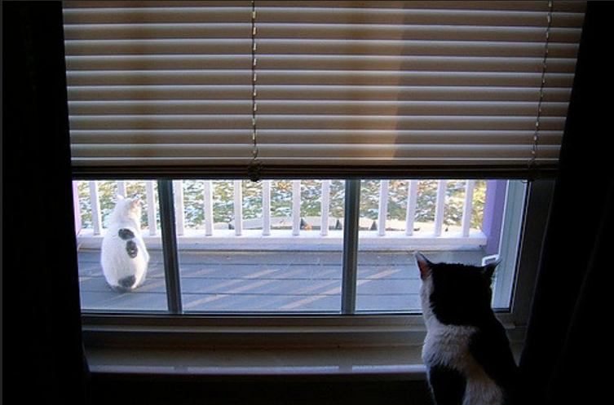
Black cat locked up, white goes ree
Maia C / maiac on Flickr
https://www.flickr.com/photos/maiac/320846855/
Notes:
This is a black cat locked up while a white cat goes free.

Slide 14
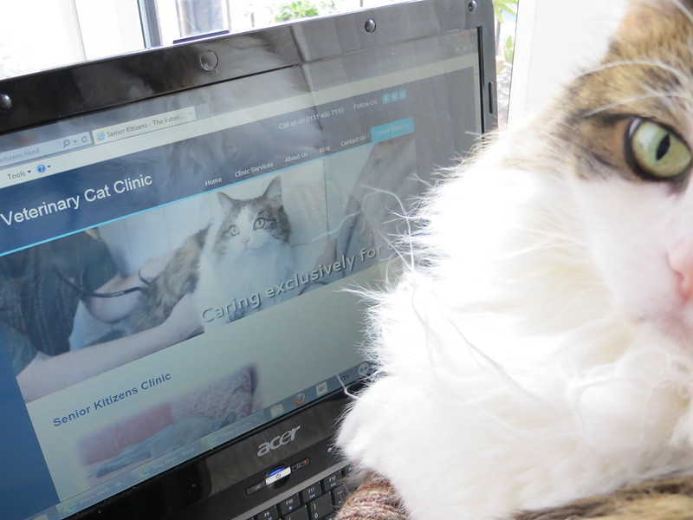
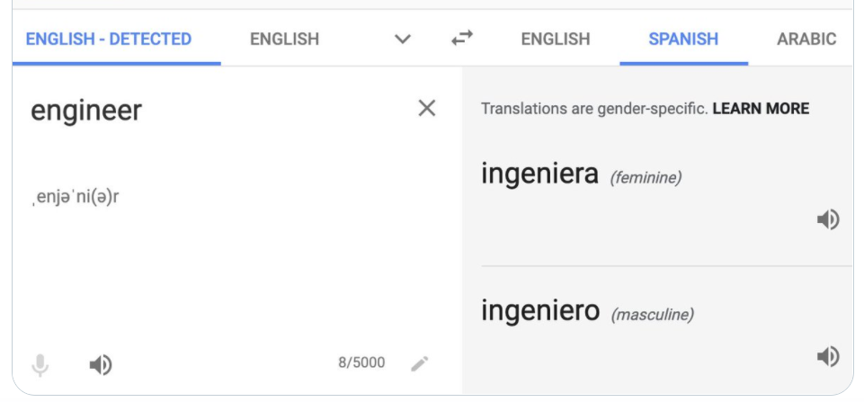

DONATED ORGAN ALLOCATION
Photo of Izzy alljengi on Flickr
https://www.flickr.com/photos/27718315@N02/9725583304/

Slide 15
Organ donation
Problem:
- more organs needed for transplant than are donated
- decision of recipient needs to be made quickly
- doctors may be tired and stressed
- decisions by different doctors may be inconsistent
- lack of transparency

Slide 16
Who gets the kidney?
Suggested by Sinnott-Armstrong et al:
- crowdsource features and A/B comparisons
- derive feature weights for participant using machine learning
- aggregate into group judgment, adjusting for ignorance / bias / confusion levels of participants
Borg, Sinnott-Armstrong & Conitzer, “Moral AI: and how we get there”, 2024
What do you think of this idea?
Notes:
My issue with this idea is, “Who gets to decide how to aggregate the group judgements? Who decides how to measure bias or confusion?” It seems to me that you’ve just changed one difficult problem into another difficult problem.

Slide 17


TECHNICAL TOOLS
Photo of Shadow wih tools
Dylan Foley / shoesfullofust on Flickr, https://www.flickr.com/photos/shoesfullofdust/3998619581

Slide 18
Technical debiasing methods
Tools for debiasing structured data processing:
see Luis Vaquero, 2021; e.g.AI Fairness 360, FAT Forensics
pre-processing, in-processing, post-processing
Debiasing word embeddings:
see e.g. Jieyu Zhao et al, 2018; Brian Hu Zhang et al, 2018
Reinforcement learning with human feedback, e.g. to train toxicity detector for gen AI - Paul Christiano et al, 2017
- good for addressing unusual toxic content, not for subtler bias to do with distribution of output
Notes:
Here’s one way in which unwanted bias can creep into structured data processing. Suppose that the set on which the accuracy of a set of weights is evaluated contains lots of items from a majority group in a population, and a smaller number of items from a minority group, and these two groups are fairly similar within themselves. Suppose there’s a small change that can be made to the weights which increases the accuracy of the output for members of the majority group, but decreases the accuracy for members of the minority group by about the same amount. Because there are more items from the majority group, on average the accuracy of the output increases. So the machine learning process may accept this change in the weights, as it will improve the overall accuracy. If this happens lots of times, during the course of the processing all the false positives and false negatives can move to the minority group. You can end up with an algorithm which is very accurate on the majority group and very inaccurate on the minority group, which suffers from all the incorrect decisions.
There are pre-processing, in-processing and post-processing techniques to deal with this problem, and the toolkits I’ve given you references for give you several options. One of the toolkits Luis Vaquero recommends is FAT forensics, a python toolkit on algorithmic accountability, fairness and transparency from the University of Bristol. Peter Flach and Raul Santos-Rodriguez gave advice on it.
To address more subtle bias in generative AI which is about the distribution of outputs rather than e.g. rare toxic words, you can try adding context; there’s an example on the next slide. Fine-tuning might possibly help as well.

Slide 19

“a portrait of a software engineer” before mitigation after mitigation
Images output by DALL-E 2, published on OpenAI blog 18 July 2022
https://openai.com/blog/reducing-bias-and-improving-safety-in=dall=e=2/
Notes:
The state before mitigation shows bias magnification: it’s less diverse than the data for actual software engineers. The way that this mitigation is done is that if DALLE-2 assesses that the user is asking for a portrait of a human, it invisibly adds demographic information such as “Asian female” to the prompt before generating the picture, following some demographic distribution – perhaps the distribution of the US population. For some applications, for instance if you’re putting up a hiring page for US-based software engineering roles, this might be what you want.

Slide 20
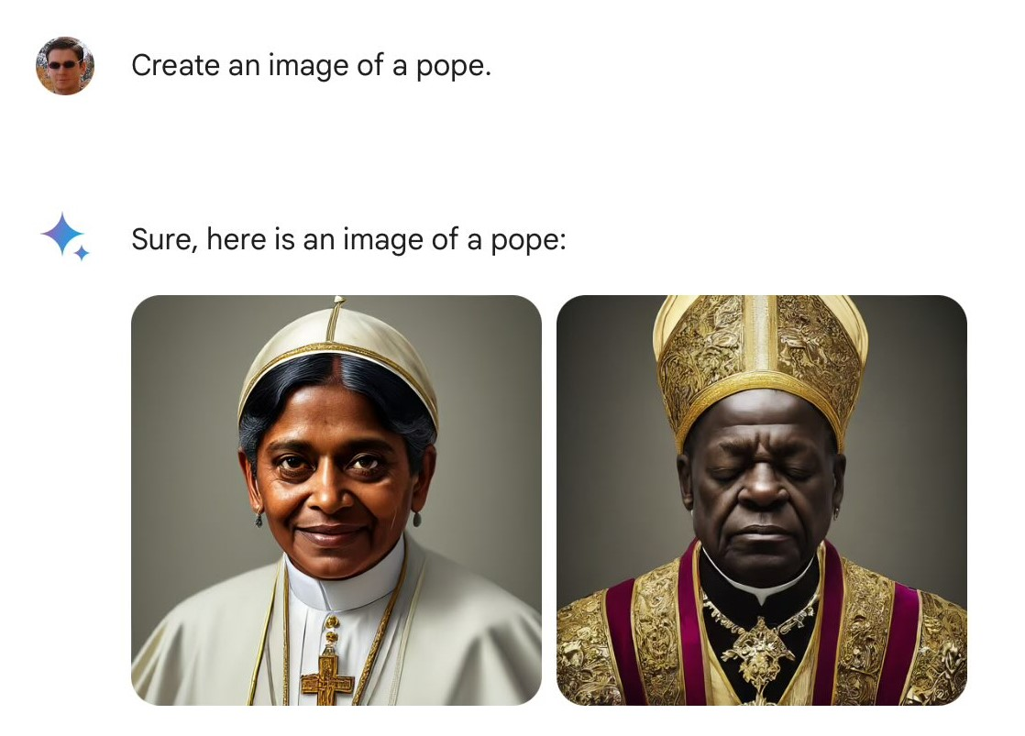
One problem with this
Images created using Gogle Gemini, tweeted 21 Feb 2023 by Frank J Fleming, https://x.com/IMAO_/status/1760093853430710557/photo/1
Notes:
For other applications though, for instance if they ask for an image of a pope, the user probably doesn’t want the generative AI to do that. It’s not obvious how to get the generative application to work out when to produce a different demographic distribution of output, unless the user specifies what they want.

Slide 21

SOURCES OF UNWANTED BIAS
Notes:
These two cats are not on a level playing field.

Slide 22

Tenant screening
TransUnion’s tenant screening
Uses machine learning:
input includes criminal record, previous tenancy disputes
$11.5m settlement of class action lawsuit re bias, June 2023
- Burns, 2023
Notes:
To talk about sources of bias, I’ll use the example of tenant screening.
Algorithmic tenant screening is used mainly owners of a large number of properties, to predict whether an applicant to be a tenant has a high risk of being evicted or leaving the property without paying rent. TransUnion is the market leader for tenant screening in the US. Its algorithm uses machine learning; two of its data sources are criminal records and records of previous tenancy disputes. In 2023 TransUnion paid $11.5m to settle a lawsuit about bias in its algorithm.

Slide 23
Some sources of unwanted bias
inaccurate / unrepresentative input data
historical & societal bias; unrepresentative sampling;
inaccurate/unrepresentative labelling; poor proxy
- bias magnification by some models
- bias feedback loop
gaming by users
different impact of same algorithmic outcome
Notes:
Here are some sources of bias in machine learning. The data for the tenant screening uses criminal records, which reflect some historical/societal bias in the fact that African-Americans are more likely to have them. There are sampling problems, in that some of the input data used in tenant screening has been from records that were later updated, rather than the updated version, which may for example have expunged some. Labelling issues can be a source of unwanted bias, for instance, if you ask an application to show you pictures of bridegrooms, even if there are pictures of Indian-style bridgrooms in its data set it may only show you western-style rather than Indian-style bridegrooms because of who did the labelling of the pictures in its data set. Another problem with input data is that it may be a poor proxy of what you want to actually measure. Often you have to use a proxy rather than measuring directly, but a poor proxy can result in inaccuracy and bias. For tenant screening, one of the best available predictors of whether a tenant is likely to pay their rent on time is evidence that they did so in the past, however that data is only rarely used in tenant screening applications because it’s not easily available to the screening companies.
Some machine learning models can amplify bias in the input data. This is mentioned in the model sheet for GPT-3, for instance, and I’ve shown an example for DALL-E 2 where before mitigation it only showed white male software engineers. For the tenancy screening example there’s bias magnification because some of the same demographic groups who are more likely to have criminal records, are also more likely among people with criminal records to have ambiguities in those records. Because of the nature of the application, the fact that landlords are more interested in avoiding bad tenants rather than getting all the good tenants, ambiguities tend to be interpreted pessimistically. So this amplifies the bias for those demographic groups. There can be a feedback loop. A feedback loop can occur where the output of one machine learning programme is used as input for another or the same programme, thus potentially locking in or even exacerbating any unwanted bias; this is of concern for instance with generative AI which outputs data on the internet, which in turn may be used to train future AI. For the tenancy screening case, suppose your rubbish landlord won’t carry out repairs and so you refuse to pay your rent. That causes a tenancy dispute. Your tenancy screening score goes down as a result, and you’ll find it more difficult than before to find a good landlord who’ll take you, so you’re more likely to end up with another rubbish landlord. I don’t think gaming by users applies to this case, but it’s something to watch out for when you think about possible ways of improving or mitigating the system. Finally, getting an unfairly low score would impact groups more who already had a limited choice of possible places to rent – for instance, people who needed wheelchair access to the accommodation. It’s not possible to see this last type of bias if you only look at the data and algorithm, you have to consider the ecosystem.
In the pre-reading you can see the recommendations by attorneys general for regulations to reduce bias for tenancy scoring, ease mitigation of inaccurate scores, and increase transparency to the tenant.

Slide 24
Tenant screening: suggestions?
Public comment by 15 State Attorneys General recommending regulations for tenant screening, 2023
Suggestions?
Notes:
Imagine you’re a State Attorney General. Do you have any suggestions?
Discrimination in housing on the basis of race is already illegal, and it’s already a requirement for tenant screening companies to validate their input data.

Slide 25
Tenant screening recommendations
- Some types of input data not allowed
Rejected tenant gets free copy of report, and right to challenge decision
Main reasons given for rejection (which data points)
If tenant shows that decision was wrong, e.g. by proof of previous rent payments, gets offered next similar vacancy
Consumer Financial Protection Bureau gets sufficient info to audit for bias, including source code & coders’ notes.
(more) - see Attorneys General, 2023
UK/EU: can have explanation of “logic” of automated decision, and human review
Notes:
These are some of the recommendations made by State attorneys general for regulating tenant screening.
They suggest for instance that data related to tenancy disputes that were resolved in favour of the tenant shouldn’t be allowed as input, and nor should data that’s been expunged from the record.
“Showing that the decision was wrong” means providing evidence that a reasonable person would think meant the decision was wrong. They suggest as an example providing evidence that you’ve previously made rental payments on time.

Slide 26
AI fairness isn’t just about debiasing models & data
which fairness criterion?
processes for discovering problems/inaccuracies
mitigation or remediation
accountability
Transparency can help
Policy & governance, not just tech
Notes:
My final comment on AI fairness is that it isn’t just about debiasing models and data.
You need policy and governance, not just tech. If there’s just one slide I’d like you to remember from this session, it’s this one.

Slide 27
Bias, Fairness and Transparency -
Miranda Mowbray
miranda.mowbray@bristol.ac.uk

Slide 28


References (First reference on a slide is main reference for that topic)
Photo TLVshac on Flickr https://www.flickr.com/photos/shacharabiry/

Slide 29
REFERENCES I
COMPAS algorithm
Arvind Narayanan, “Tutorial: 21 Fairness Definitions and their Politics”, FAccT 2018, http://www.youtube.com/embed/jIXIuYdnyyk
World Prison Brief, http://www.prisonstudies.org , May 2024
Jennifer Skeem & Christopher Lowenkamp, “Risk, Race and Recidivism: predictive bias and disparate impact”, 2016 http://bit.ly/3uyQGqb
Julia Angwin et al, “Machine Bias”, ProPublica 23 May 2016 http://www.propublica.org/article/machine-bias-risk-assessments-in-criminal-sentencing
Northpointe Ltd, “Sample risk assessment – COMPAS core”, https://www.documentcloud.org/documents/2702103-Sample-Risk-Assessment-COMPAS-CORE.html
- Julia Dressel & Harry Farid, “The accuracy, fairness, and limits of predicting recidivism”, Science Advances, 2018 (comparison with human accuracy/bias) http://www.ncbi.nlm.nih.gov/pmc/articles/PMC5777393/

Slide 30
REFERENCES II
European Commission AI Ethics Guidelines
- High-level expert group on AI, “Ethics Guidelines for Trustworthy AI”, 2019 https://www.aepd.es/sites/default/files/2019-12/ai-ethics-guidelines.pdf
Bias magnification examples
- Gretchen Krueger et al, GPT-3 model card, http://github.com/openai/gpt-3/blob/master/model-card.md
Jieyu Zhao et al, “Men also like shopping”, Empirical Methods in NLP 2017 http://arxiv.org/pdf/1707.09457.pdf

Slide 31
REFERENCES III
Donated Organ Allocation
- Walter Sinnott-Armstrong & Joshua Skorburg, “How AI Can Aid Bioethics”, Journal of Practical Ethics, 2021 https://journals.publishing.umich.edu/jpe/article/id/1175/
Anthony Attia et al, “Effect of recipient age on prioritization for liver transplantation in the UK”. The Lancet Healthy Longevity, 5(5) e346-e355 https://www.pure.ed.ac.uk/ws/portalfiles/portal/441047281/Effect_of_recipient_age_ATTIA_DOA01052024_VOR_CC-BY.pdf
Madhumita Murgia, “Algorithms are deciding who gets organ transplants. Are their decisions fair?” Financial Times [may be paywalled]
https://www.ft.com/content/5125c83a-b82b-40c5-8b35-99579e087951?shareType=nongift

Slide 32
REFERENCES IV
Technical Tools for Debiasing
- Luis Vaquero, “Fairness in AI: Pros and cons and toolboxes”, blog post April 2021: eg AI Fairness 360
https://www.linkedin.com/pulse/fairness-ai-pros-cons-toolboxes-luis-m-vaquero/
- FAT Forensics, tool for structured data processing from UoB (included in list of toolboxes above) http://fat-forensics.org
Jieyu Zhao et al, “Learning gender-neutral word embeddings”, EMNLP 2018, https://arxiv.org/pdf/1809.01496.pdf
- Brian Hu Zhang, Blake Lemoine & Margaret Mitchell, “Mitigating unwanted biases with adversarial learning”, AIES 2018 https://www.aies-conference.com/2018/contents/papers/main/AIES_2018_paper_162.pdf
- Paul F Christiano, Jan Leike, Tom B Brown, Miljan Martic, Shane Legg & Dario Amodei, “Deep Reinforcement Learning from Human Preferences”, Neurips 2018 https://proceedings.neurips.cc/paper_files/paper/2017/file/d5e2c0adad503c91f91df240d0cd4e49-Paper.pdf

Slide 33
REFERENCES V
Tenant Screening
Public comment on tenant screening from 15 State Attorneys General, 30 May 2023 http://tinyurl.com/5fyxvj6u
TransUnion press release about ResidentScore 3.0,18 Sept 2019 https://newsroom.transunion.com/property-managers-gain-greater-predictive-power-to-help-further-decrease-future-evictions/
Rebecca Burns, Jacobin article 27 June 2023 https://jacobin.com/2023/06/artificial-intelligence-corporate-landlords-tenants-screening-crime-racism
Consumer Finance Protection Bureau, “Errors and false information in tenant background checks raise costs and barriers to quality rental housing”, 15 Nov 2022
https://www.consumerfinance.gov/about-us/newsroom/cfpb-reports-highlight-problems-with-tenant-background-checks/

